Slide 1
DEVELHOPE
TEAM WORK
presentation

Slide 2
AGENDA
Explaining code​
Code execution
​Output of code
Insights explanation
​

Slide 3

Explaining code

Slide 4
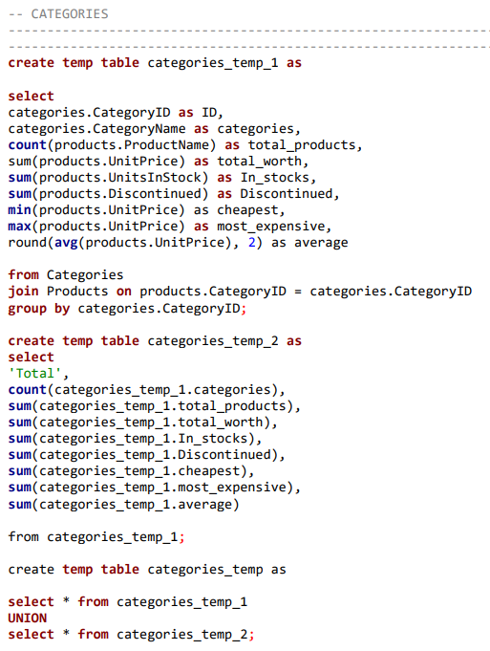
Table_1

Slide 5
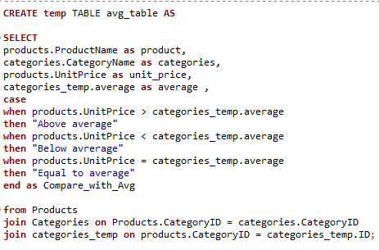
Table_2

Slide 6
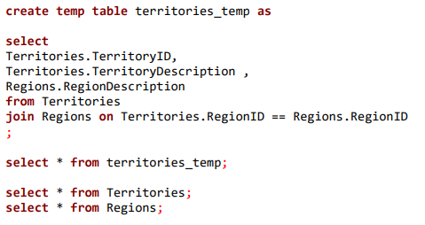
LAST TABLE

Slide 7
RESULTS
& INSIGHTS

Slide 8
THANK YOU

